Slide 1
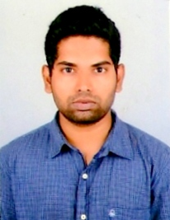
Senior Systems Engineer– Venkata Ramana
Summary of Experience
Project experience
4 years of IT experience in developing front end applications.
Worked extensively in Agile scrum environment with JIRA.
Has expertise in Angular 2/4, Enterprise applications development.
Good Team Player and can communicate effectively.
Angular-4
Angular Material,
HTML5/CSS
Project – A Distribution and supply chain management application allows distributors and retailers to evaluate pre-sales and post-sales market. Ease of tracking Goods and Payment. Distributor/ Retailer can raise issues against the order and track the issue.
Key components – Router, Lazy loading, Services, Angular CLI, Flex Layout for responsiveness.
Technology involved - Angular 4, Angular Material, Chart.js.
Project – An Event Management application allows Managers, and Delivery Head’s to register for an event, Book accommodation and even Travel.
Key components – Three Module viz. Admin , Participants and Faculty .
Technology involved - MEAN ( MongoDB, Express server, Angular , Node ).
MEAN stack
Details
Primary Skills – Angular 2/4, JavaScript, Ionic Framework, MEAN stack (trained).
Other Skills – HTML, CSS, Typescript, bootstrap , angular material , chart.js, API Integration ( Facebook, google, twitter ).
IDE/Tools – MS Visual studio , Atom, Git.
Certification/Works :
Certified MEAN stack developer from NIIT.
Done my Internship for 3 months in browse-easy startup.
Developed many reusable components and Layouts in previous organization.
Created projects/repositories in my github ( mulagura ) and got applaud from team.
Project – Project is about DMS(Data Management software).It’s having various modules like Vendors, Rentals and miscellaneous. The software manages whole set of data for time tracking, cost cuttings etc.
Key components – Angular Material, Google Map API, UI Grid.
Technology involved - Angular, HTML/CSS
Angular with Material

